Slide 1
Topic: Measurement EQ: How do I find the perimeter and area of a Rectangle?
Year 11 Essentials

Slide 2
Things Required For This Lesson
Interactive Notebook
Textbook: Interleaved Maths Essential Connections
Ruler, Red Pen, Pencil, Pens, Scientific Calculator
Growth mindset

Slide 3
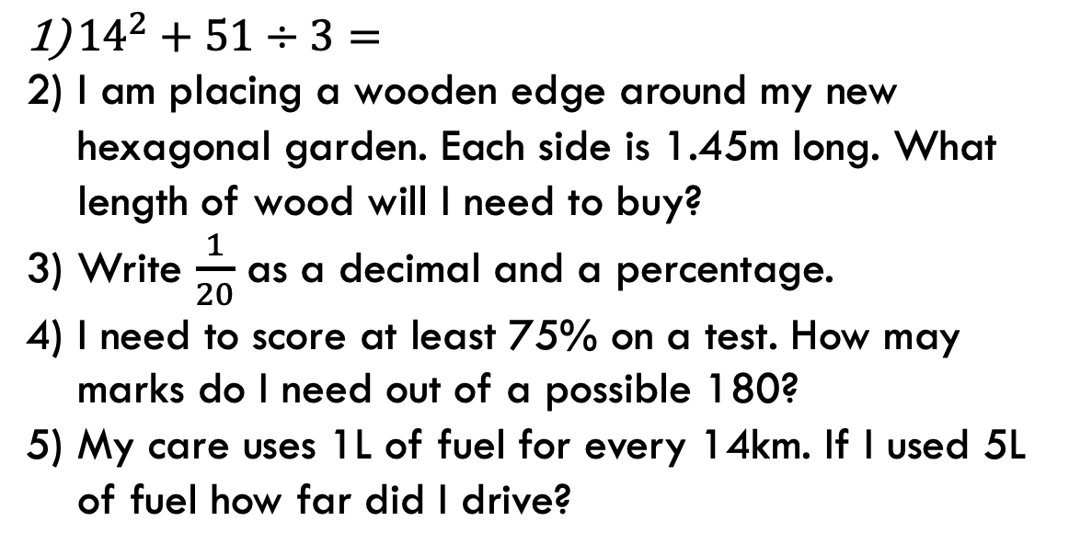
First 5
Answers
1) 213
2) 8.7m
3) 0.05, 5%
4) 135 marks
5) 70km
${14}^{2}+51÷3=$
I am placing a wooden edge around my new hexagonal garden. Each side is 1.45m long. What length of wood will I need to buy?
Write $\frac{1}{20}$ as a decimal and a percentage.
I need to score at least 75% on a test. How may marks do I need out of a possible 180?
My care uses 1L of fuel for every 14km. If I used 5L of fuel how far did I drive?

Slide 4
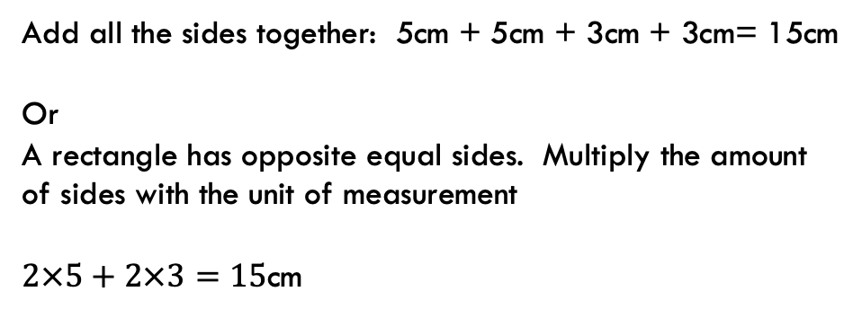
24
7
30
Topic: Measurement
EQ: How do I find the perimeter and area of a rectangle?
What is Perimeter?
Is the distance along the boundary of a shape
Some examples:
A fence is built along the perimeter of a property
A soccer pitch has boundary lines along the perimeter
Example:
Add all the sides together: 5cm + 5cm + 3cm + 3cm= 15cm
Or
A rectangle has opposite equal sides. Multiply the amount of sides with the unit of measurement
$2×5+2×3=15$cm
5cm
3cm
WICOR

Slide 5
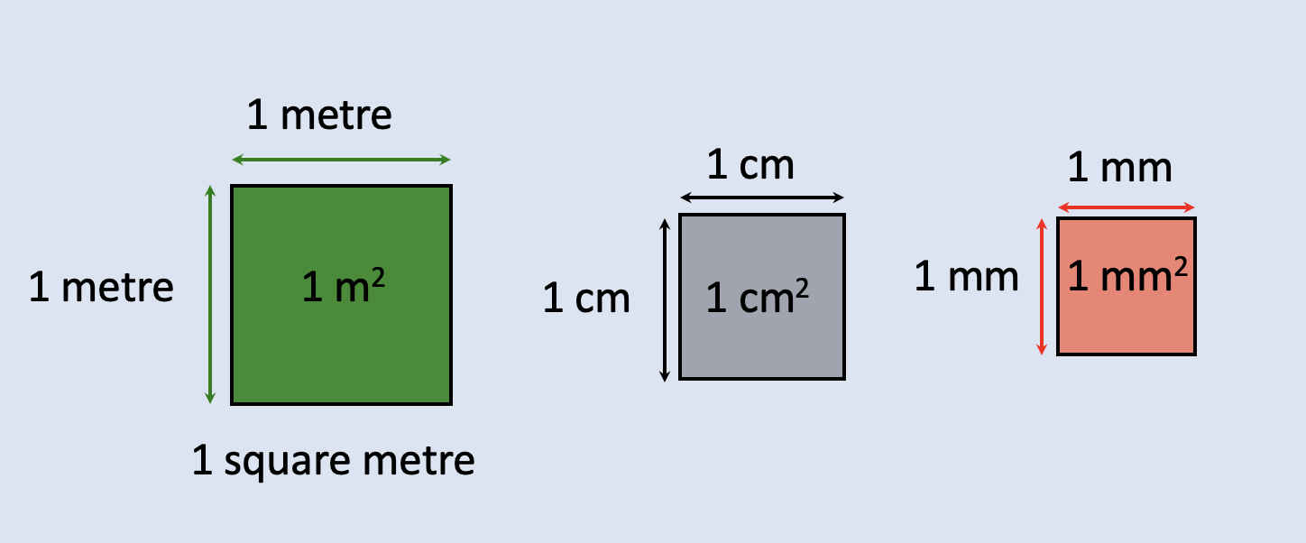
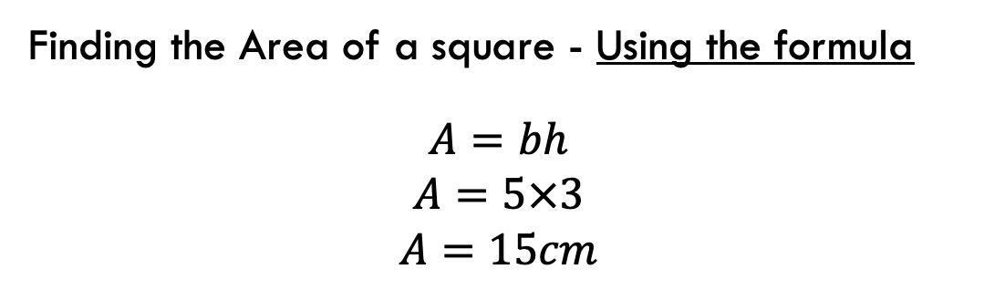
24
7
30
Topic: Measurement
EQ: How do I find the perimeter and area of a rectangle?
Area measures the surface of of 2D shape. It is measured in square units.
What is Area?
Example:
Finding the Area of a square - Using the formula
$$A=bh$$
$$A=5×3$$
$$A=15cm$$
5cm
3cm
WICOR

Slide 6
Practise
Using grid paper complete the experiment on page 64.
Square | Base length | Height | Area enclosed | Pattern or Formula
A
B
C
D
E

Slide 7
Practise
Area of Rectangles and Squares worksheet.
Finished?
With a partner design a studio apartment using a rectangle and squares as a base for rooms and furniture. Include a scale for

Slide 8

Thank you
Keep up the good work!
Quote of the day – ”Work hard and good things will come.”

